Slide 1

Retail Inventory Predictor
Binary Brains team: Ambalika, Favour, Joseph, Misty, & Zaid
Data Collector: Identify potential data sources and outline data collection methods.
Misty
Algorithm Designer: Choose suitable algorithms and justify your selection.
Ambalika
Model Trainer: Propose strategies for model training and validation.
Favour & Zaid
Application Specialist: Plan the integration of the ML model into a real-world application
Joseph Hiller

Slide 2
DATA COLLECTOR
Internal Data
External Date
Data collection methods
Data collection tools, technologies, and processing

Slide 3

INTERNAL DATA
Historical sales data (quantities, dates, product types, locations)
Inventory levels
Pricing data
Customer data (purchase history, demographics, preferences)
Marketing and promotional activity data
Customer feedback and reviews
Point-of-sale (POS) data from authorized resellers
Manufacturing and production data from their suppliers and contract manufacturers
Warehouse and distribution center data on stock levels and movements
Sales forecasts and demand planning data from various departments
Customer returns and warranty claims data
Online Sales Platforms:
E-commerce platforms, official website or third-party online retailers, gather data on online sales. These platforms capture information about product availability, sales volume, and customer orders.
Supply Chain and Manufacturing Systems:
internal systems and suppliers' systems provide data on manufacturing, shipment, and delivery of products. This includes information on inventory levels, production schedules, and logistics.

Slide 4

EXTERNAL DATA
Market trends and research
Industry reports
Economic indicators
Competitor data
Weather patterns
Local events
Market research reports on consumer demand and industry trends
Shipping and logistics data from partners and carriers
Economic indicators and global events that might impact supply or demand
Social media trends & sentiment analysis to gauge product popularity

Slide 5

ALGORITHM DESIGNER
Algorithm selection : Long Short-Term Memory (LSTM)

Slide 6
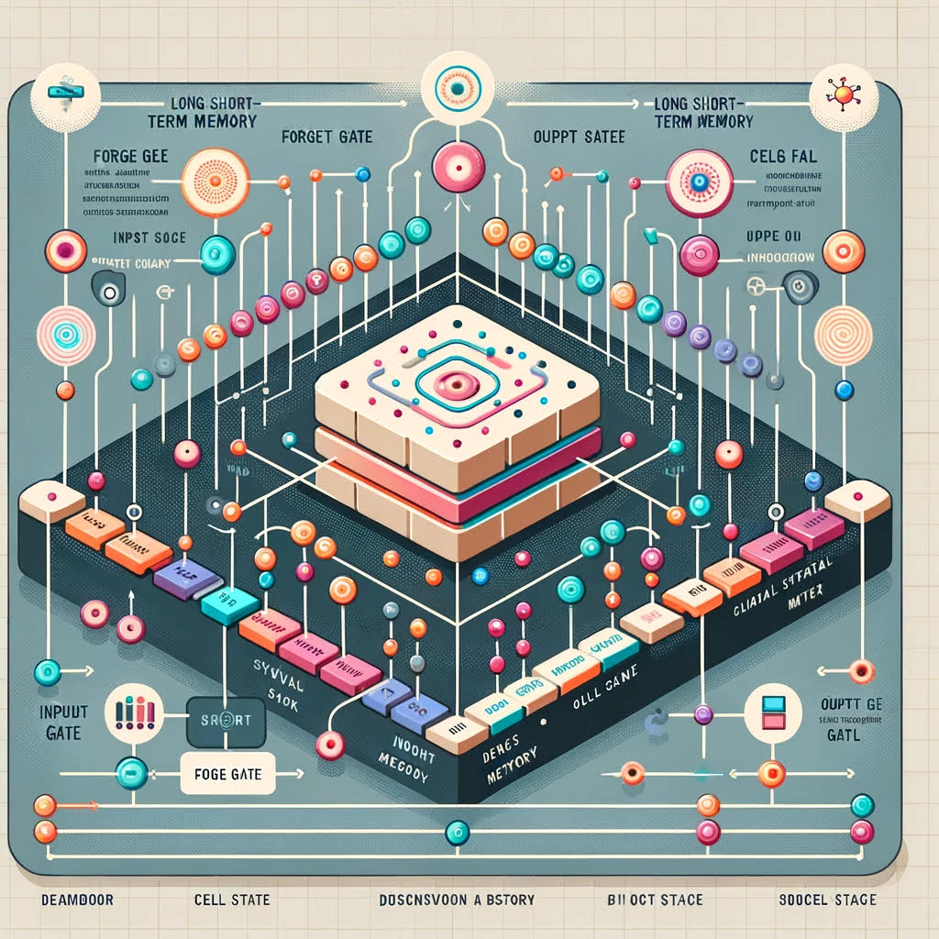
What is LSTM
Long Short-Term Memory (LSTM) networks are a type of Recurrent Neural Network (RNN) that are particularly well-suited for sequential data analysis, making them a suitable choice for forecasting tasks such as retail inventory management, especially in the context of Apple retail stores.

Slide 7

Why LSTM
Sequential Data Handling
Long-Term Dependencies
Handling Non-Linear Relationships
Ability to Handle Multivariate Time Series
Adaptability to Data Dynamics

Slide 8
Assumptions
LSTM assumes that past patterns and dependencies within the data will continue, which may not always hold true in rapidly changing retail environments. However, LSTM's adaptability helps mitigate this assumption by continuously updating the model with new data from Apple retail stores.
LSTM performance relies on the availability and quality of historical data from Apple retail stores. Insufficient or noisy data may hinder the model's ability to accurately capture patterns and make reliable forecasts, emphasizing the importance of data quality and preprocessing.
While LSTM is effective for sequential data analysis, it may not perform optimally if the underlying demand patterns in Apple retail stores are highly irregular or unpredictable. Additional feature engineering or preprocessing may be necessary to enhance model performance and address specific characteristics of Apple retail sales data.

Slide 9
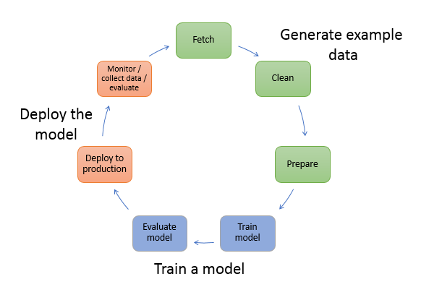
MODEL TRAINER- FAVOUR & ZAID
The process begins with collecting relevant data from various sources. This data could be structured or unstructured, depending on the problem being solved.
After collecting data, data is process and ensures the input data is clean, normalized, and appropriately structured, allowing the model to learn patterns effectively and preventing issues like vanishing or exploding gradients during training.
Model building stage design an LSTM neural network architecture suitable for time series forecasting. Configure the number of layers, neurons, and other hyperparameters. Incorporate dropout layers to prevent overfitting.
Train the LSTM model using the training set. Utilize backpropagation through time (BPTT) to update weights. Use an appropriate optimization algorithm (e.g., Adam, RMSprop).
Hyperparameter tuning is the process of systematically optimizing the configuration settings, known as hyperparameters, of a machine learning model to improve its performance on a specific task. These hyperparameters, such as learning rates or the number of hidden layers, are external to the model and are adjusted through experimentation to achieve optimal results.
Model Evaluation: Assesses the model's accuracy, helping ensure that the forecasting results are reliable and can be trusted for making informed inventory optimization decisions.

Slide 10
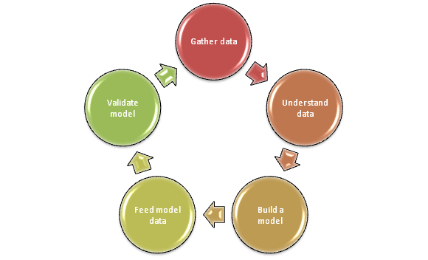
Model training cont.
Fine-Tuning: in this stage adjustments make to the model based on validation results, ensuring its continual improvement and adaptability to evolving patterns in demand data. Repeat training and evaluation until satisfactory performance is achieved.
The goal of model validation is to ensure that the model has learned meaningful patterns from the training data and can make accurate predictions on new, unseen data. There are several methods for model validation, each with its advantages and suitability depending on the dataset size, computational resources, and specific requirements of the problem. Here are some common validation methods:
Time Series Cross-Validation technique used in training models, particularly for time-dependent data like in forecasting, where the dataset is split into multiple consecutive folds, ensuring that each fold's training data precedes the validation data, mimicking real-world scenarios and providing a more reliable evaluation of a model's performance over time. This approach helps assess the model's ability to generalize and make accurate predictions on unseen future data points, considering the temporal dependencies inherent in time series datasets.
Holdout validation is a technique where a portion of the dataset is reserved for final model evaluation after training and tuning, ensuring an unbiased assessment of the model's performance on unseen data.

Slide 11

APPLICATION SPECIALIST
Understanding the Application Context:
Understand the specific needs of Apple’s inventory management system.
Identify how the LSTM model can enhance its performance.
Understand the data flow, the current technology stack, and how predictions from the LSTM model can be utilized for decision-making.
API Development:
Develop an API that serves as a bridge between the application and the LSTM model.
Ensure the API can handle large volumes of data and is robust enough to handle any potential errors or exceptions.
Model Deployment:
Deploy the LSTM model in a production environment.
Choose a suitable platform for deployment and ensure the model is accessible by the application.
Set up necessary security measures.

Slide 12

Application Specialist
Integration with the Application:
Integrate the deployed LSTM model with Apple’s inventory management application.
Modify the application to call the model’s API, pass the necessary inputs, and use the model’s output for decision-making.
Testing:
Conduct rigorous testing to ensure the integrated system functions as expected.
Validate that the model’s predictions are correctly interpreted by the application and that the system meets the required performance standards.
Fix any bugs or issues identified during the testing phase.
Monitoring and Updating:
Set up a monitoring system to continuously track the performance of the LSTM model and the overall system.
Update the LSTM model as needed to maintain the accuracy of the inventory predictions.

Slide 13
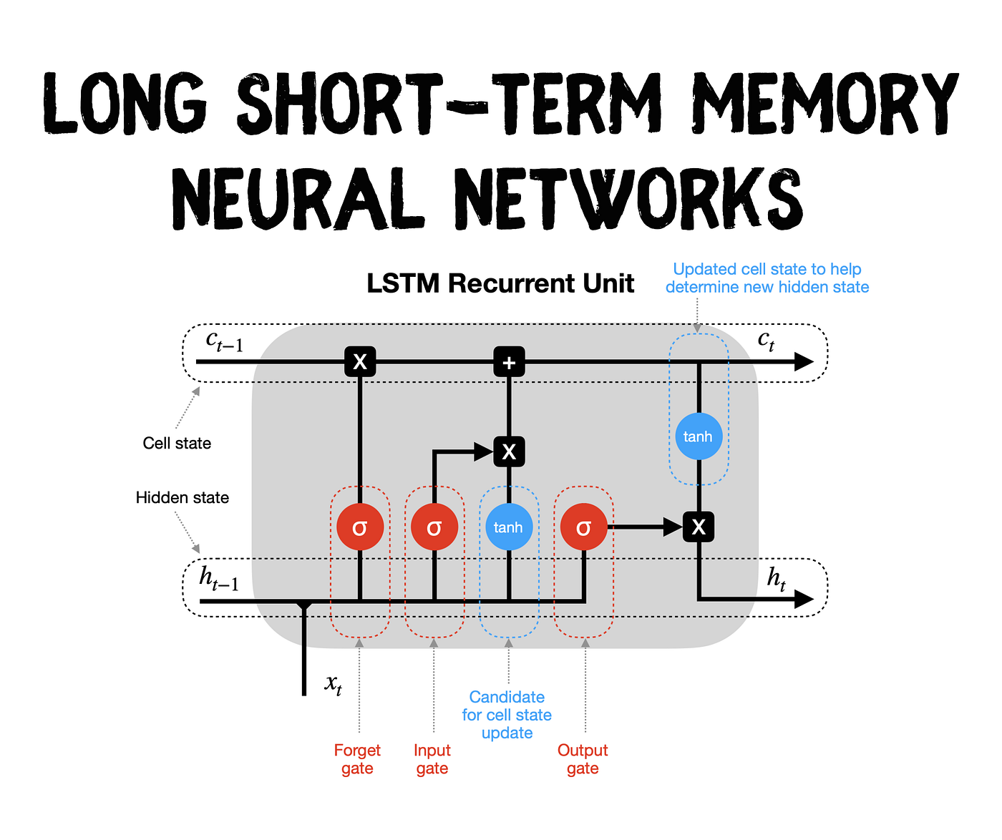
MODEL OVERVIEW
The model for forecasting product demand for inventory management is an LSTM neural network that undergoes a structured process:
Data Preprocessing: Clean, normalize, and structure the input data. Time Series Split: Split data into training and testing sets, preserving chronological order.
Feature Engineering: Extract relevant features for improved prediction.
Model Architecture: Design LSTM architecture with appropriate layers and hyperparameters.
Model Training: Train the LSTM model using backpropagation and optimization algorithms.
Hyperparameter Tuning: Optimize hyperparameters for improved performance.
Model Evaluation: Assess model accuracy using performance metrics on validation data.
Fine-Tuning: Refine the model based on validation results.
Validation Methods: Use time series cross-validation and holdout validation.
Performance Monitoring: Regularly monitor and update the model's performance on new data.
This meticulous approach ensures the model's effectiveness in capturing temporal dependencies and optimizing inventory management decisions.

Slide 14

CONCLUSION
Developed a Retail Inventory Predictor system to optimize inventory management.
Comprehensive data collection from internal and external sources.
Selection of Long Short-Term Memory (LSTM) algorithm for demand forecasting.
Rigorous model training, validation, and performance evaluation.
Seamless integration of the ML model into real-world application.
Potential impact includes improved inventory efficiency and customer satisfaction.
Challenges and Opportunities:
Challenges: Data quality assurance, dynamic retail environment, implementation hurdles.
Opportunities: Data refinement, algorithmic enhancements, continuous model monitoring.
Future Directions:
Further refinement of data collection methods and algorithms.
Exploration of advanced technologies like reinforcement learning.
Continuous monitoring and updating of the model for improved performance.

Slide 15
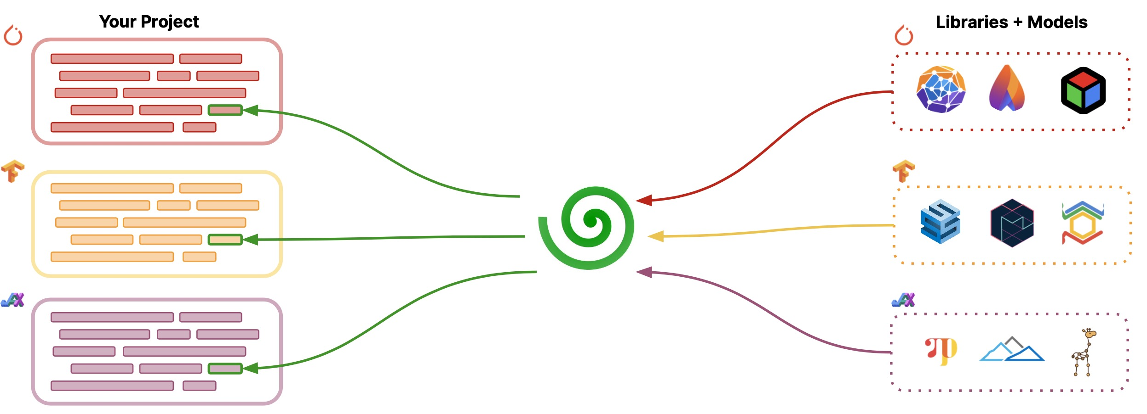
Conclusion
The Retail Inventory Predictor offers significant potential for enhancing inventory management in Apple retail stores.
Careful attention to data quality, algorithm selection, and application integration is essential for success.
Continuous improvement and adaptation are necessary to address evolving challenges and opportunities.
The model represents a step forward in leveraging AI for optimizing retail operations and driving business value.

Slide 16
Thank you
The "Binary Brains" team expresses gratitude for this opportunity.
We look forward to further collaboration and exploration of AI-driven solutions for inventory management challenges.
Questions and feedback are welcome

Slide 17

Q&A- COMMON QUESTIONS
How does a company improve inventory processes based off their past inventory shortages?
How do companies process for creating a needs forecast?
How do companies keep fairly accurate inventory?

